Slide 1
CARS HUB

Slide 2
TABLE OF CONTENTS
01
04
About the Project
Main Page
02
05
User Stories
Sign Up/In pages
03
06
System Design
Cars and Fliterations
What we are
working on
The main page of our project
A selection of
core user stories
Sign up and log in
Pages in the project
A high-level view of how system components interact.
Here you could describe
the topic of the section

Slide 3
ABOUT THE PROJECT
Car reservation website that enables users to conveniently search, view, and book rental cars online.

Slide 4
Core User Stories
As a user, I want to sign up with my email, phone number, ID, and password so that I can create a secure account.
As a user, I want to browse all available cars so that I can choose one that suits my needs.
As a user, I want to filter cars by price, car type, and availability so that I can find options that match my preferences
As a user, I want to view car details including brand, model, photos, number of seats, and type so that I can choose one.
As a user, I want to book a car for a specific rental period so that I can use it when needed.
As a user, I want to read reviews from past renters so that I can trust the quality of the cars.

Slide 5
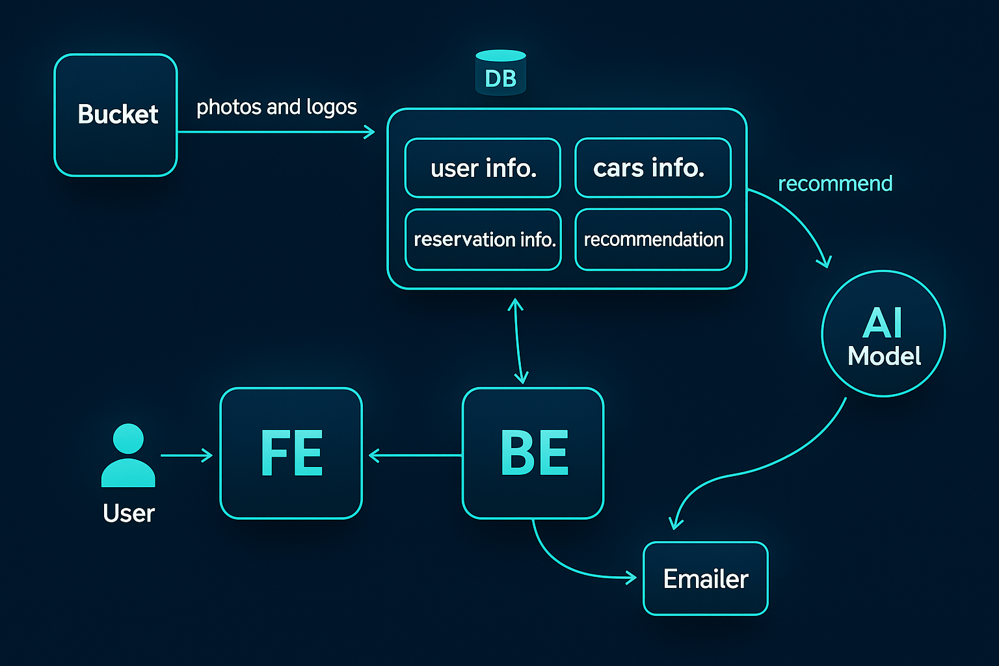
System Design

Slide 6
OUR COMPANY
GOSTUDIO
Mercury is the closest planet to the Sun and the smallest one in the Solar System—it’s only a bit larger than our Moon. The planet’s name has nothing to do with the liquid metal since it was
named after the Roman messenger god, Mercury.

Slide 7
WHAT WE ARE WORKING ON
SECURE
ACCESSIBLE
FAST AND RELIABLE
Mercury is the closest planet to the Sun
Despite being red, Mars is a cold place, not hot
Neptune is the farthest planet from the Sun

Slide 8
As a user, I want to sign up and verify my email and phone so that my account is secure.
As a user, I want to log in using email, phone, or Google so that I can access my account easily.
As a user, I want to browse and filter cars by price, type, and availability so that I can find the right car.
As a user, I want to view detailed information and reviews about each car so that I can make an informed choice.
As a user, I want to book a car with a time gap check so that my reservation doesn’t conflict with others.
As a user, I want to receive and confirm a booking email within 30 minutes so that my reservation is secured.
As a user, I want to collect loyalty points and get discounts so that I’m rewarded for renting frequently.
As a user, I want to use the site easily on mobile or desktop so that I can rent a car from any device.

Slide 9
NOW
POOR DESIGN
PROGRAMMING MISTAKES
LACK OF ADAPTABILITY

Slide 10
FUTURE
BRANDING
POSITIONING
ADAPTABILITY

Slide 11
MAJOR REQUIREMENTS
IMAGES
USER EXPERIENCE
INFORMATION
Despite being red, Mars is a cold place, not hot. It’s full of iron oxide dust
Venus has a beautiful name and is the second planet from the Sun
Mercury is the closest planet to the Sun and the smallest in our Solar System

Slide 12
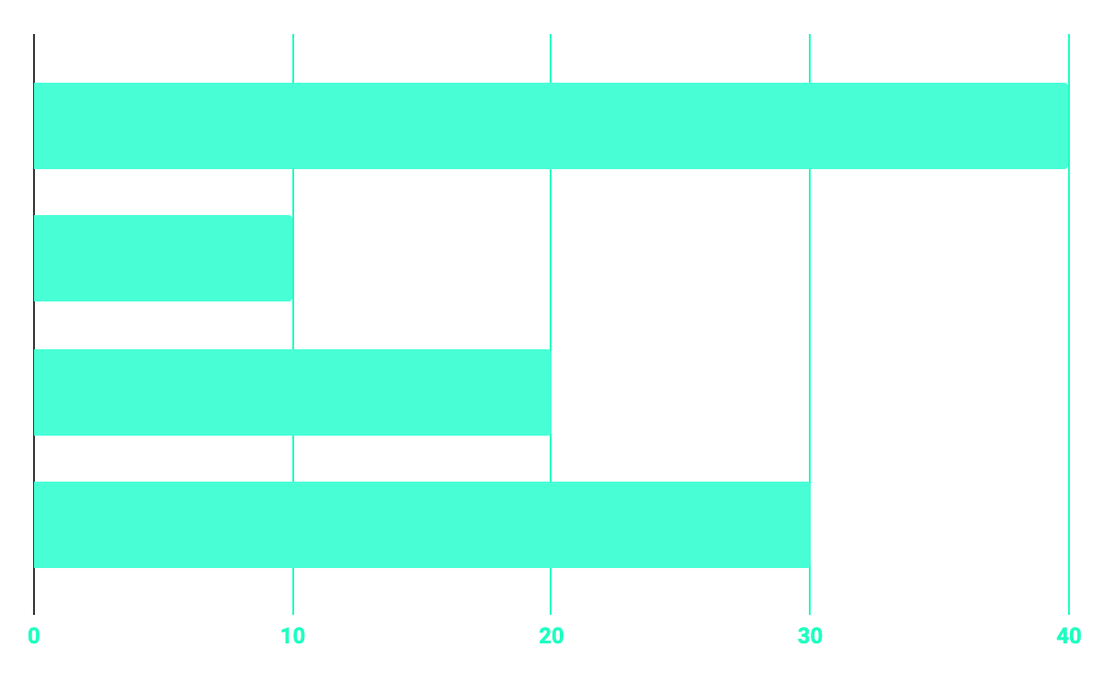
BUDGET
40%
20%
PROGRAMMING
10%
30%
DATABASE
WEB DESIGN
UX RESEARCH

Slide 13
OUR GOALS
EXPANSION
POSITIONING
USABILITY
Neptune is the fourth-largest planet in our Solar System
Venus has a beautiful name and is the second planet from the Sun
Despite being red, Mars is a cold place, not hot. It’s full of iron oxide dust

Slide 14
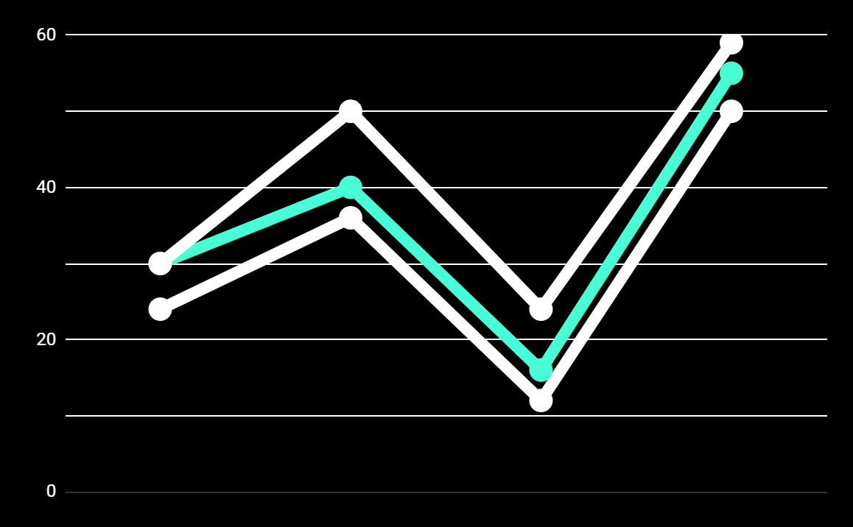
PREDICTED RESULTS
CONVERSIONS NEXT YEAR
+20%
MONTHLY VISITS
+33%
CONVERSION RATE
+40%
ANNUAL ORDERS

Slide 15
SNEAK PEEK
HEADER
TEXT
SLIDER
ICONS

Slide 16
A VIDEO IS A GOOD IDEA
Insert your multimedia content here

Slide 17
PROJECT STAGES
STEP 2
STEP 1
STEP 3
Venus has a beautiful name and is the second planet from the Sun
Despite being red, Mars is a cold place, not hot. It’s full of iron oxide dust
Saturn is a gas giant, composed mostly of hydrogen and helium

Slide 18
OUR TIMELINE
WEEK 1
WEEK 3
BETA
RELEASE
FINAL
VERSION
WEEK 2
WEEK 4
Improvements
Increased traffic
Focus group
Progress review

Slide 19
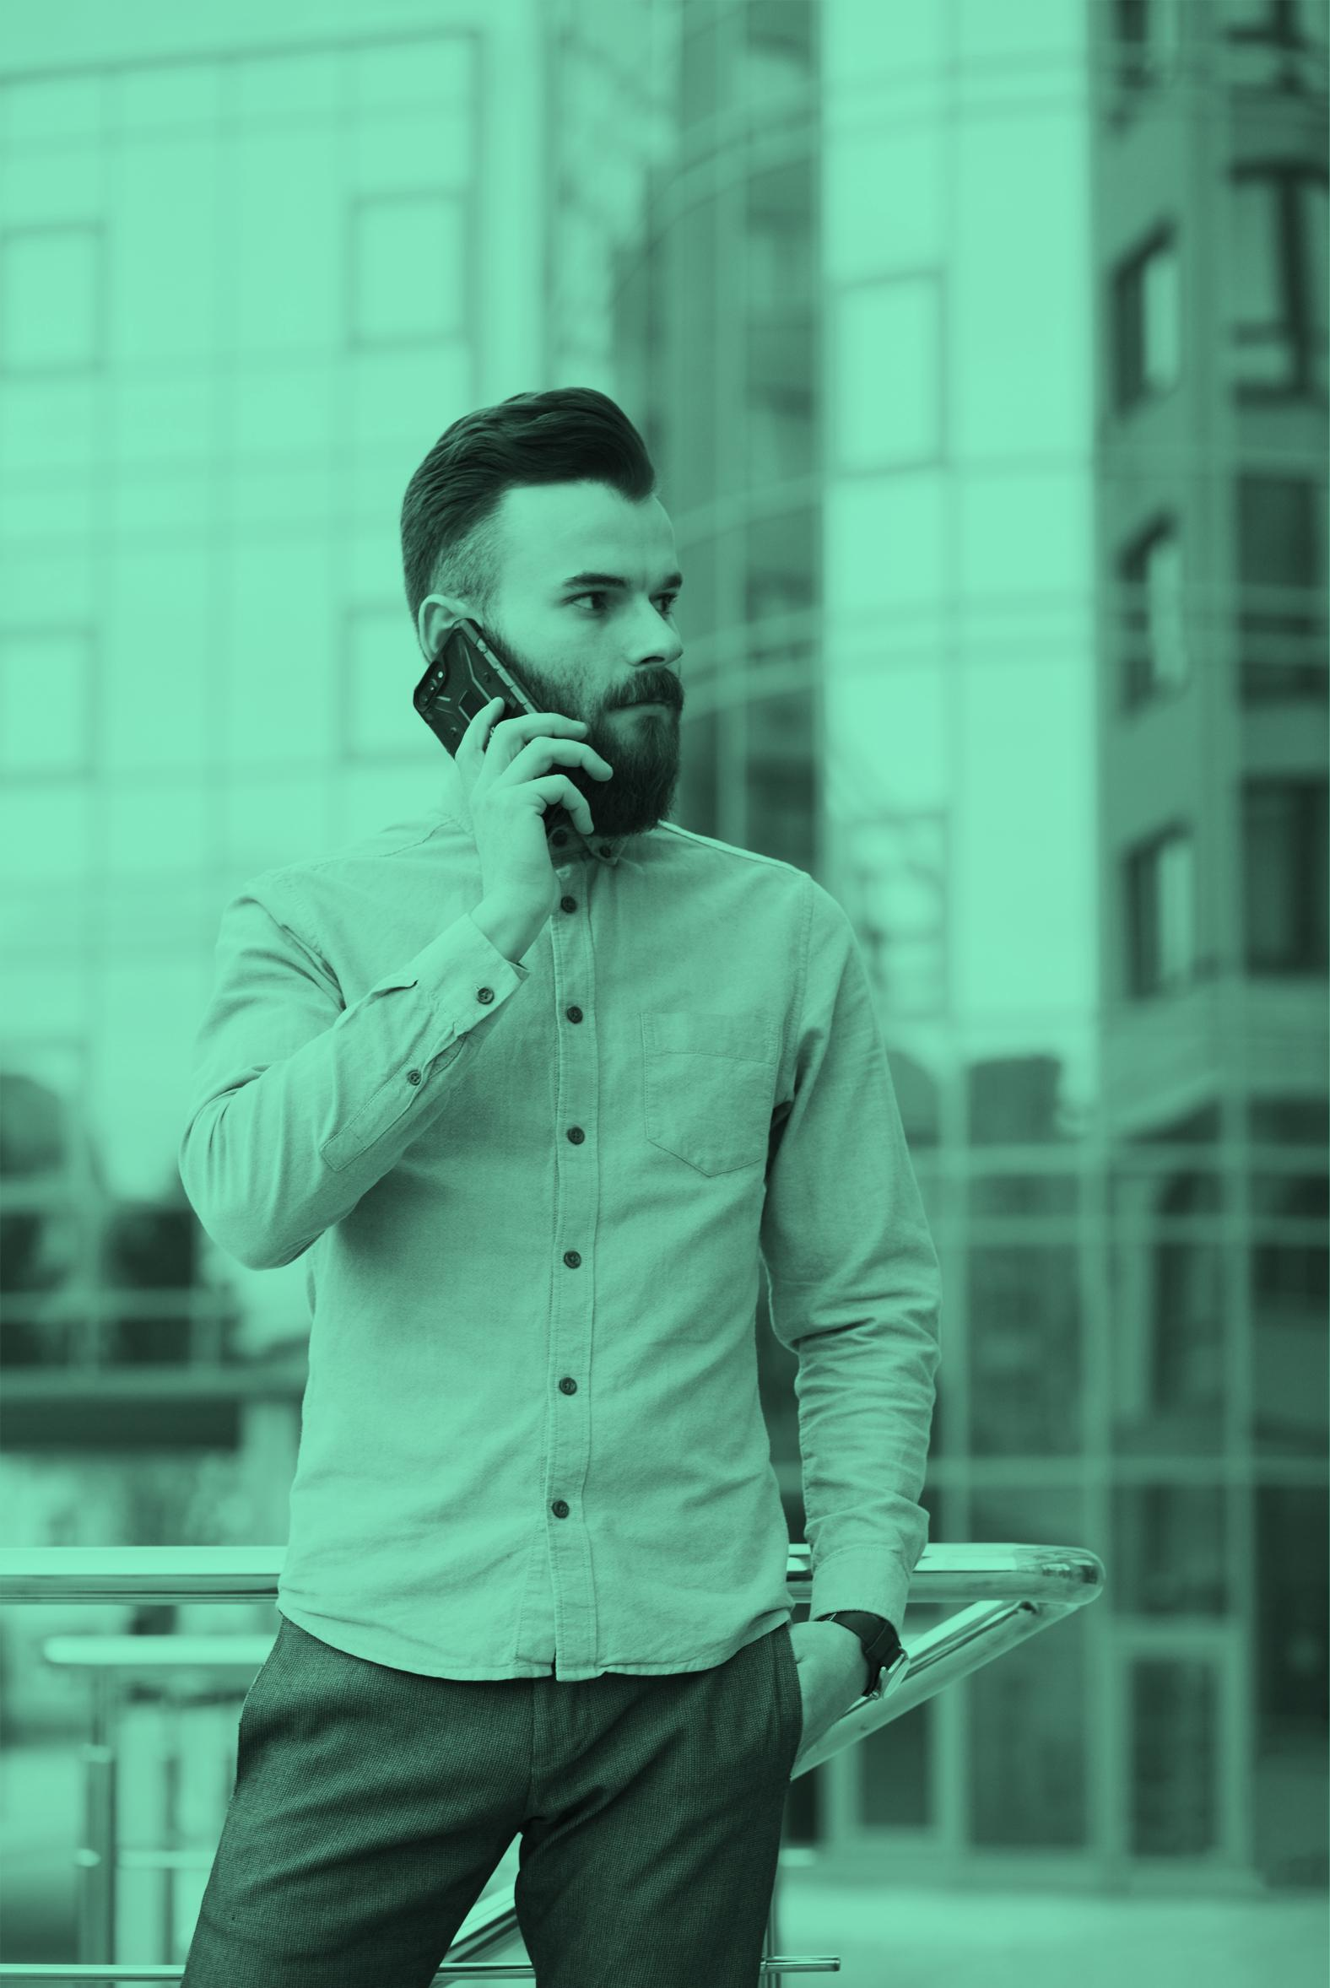


THE TEAM
JENNA DOE
JOHN DOE
JIMMY DOE
You can replace the image on the screen with your own
You can replace the image on the screen with your own
You can replace the image on the screen with your own

Slide 20
THANKS!
Does anyone have any question?
addyouremail@freepik.com
+91 620 421 838
yourcompany.com

Slide 21
CREDITS
This is where you give credit to the ones who are part of this project.
Presentation template by Slidesgo
Icons by Flaticon
Infographics by Freepik
Images created by Freepik
Author introduction slide photo created by Freepik
Text & Image slide photo created by Freepik

Slide 22
RESOURCES
Did you like the resources on this template? Get them for free at our other websites.
PHOTOS
Young businessman with hands in his pocket talking on mobile phone
Smiling ethnic woman with gray laptop
Smiling young man busy in texting message to someone
VECTORS
Flat computer engineering concept
Circuit of user experience
Timeline infographic
Logotype collection
Flat social media multimedia player templa
Gradient technology logo template collection
Digital marketing landing page template
Colorful responsive landing page
Modern web design concept with hand drawn style
App development concept with flat design

Slide 23
Instructions for use
In order to use this template, you must credit Slidesgo by keeping the Thanks slide.
You are allowed to:
- Modify this template.
- Use it for both personal and commercial projects.
You are not allowed to:
- Sublicense, sell or rent any of Slidesgo Content (or a modified version of Slidesgo Content).
- Distribute Slidesgo Content unless it has been expressly authorized by Slidesgo.
- Include Slidesgo Content in an online or offline database or file.
- Offer Slidesgo templates (or modified versions of Slidesgo templates) for download.
- Acquire the copyright of Slidesgo Content.
For more information about editing slides, please read our FAQs:
https://slidesgo.com/faqs

Slide 24
Fonts & colors used
This presentation has been made using the following fonts:
Roboto
(https://fonts.google.com/specimen/Roboto+bold)
Roboto
(https://fonts.google.com/specimen/Roboto+Thin)
#48ffd5
#0e2a47
#ffffff

Slide 25





Storyset
Create your Story with our illustrated concepts. Choose the style you like the most, edit its colors, pick the background and layers you want to show and bring them to life with the animator panel! It will boost your presentation. Check out How it Works.
Pana
Amico
Bro
Rafiki
Cuate

Slide 26
Use our editable graphic resources...
You can easily resize these resources without losing quality. To change the color, just ungroup the resource and click on the object you want to change. Then, click on the paint bucket and select the color you want. Group the resource again when you’re done. You can also look for more infographics on Slidesgo.

Slide 29
JANUARY
FEBRUARY
MARCH
APRIL
MAY
JUNE
PHASE 1
Task 1
Task 2
PHASE 2
Task 1
Task 2
JANUARY
FEBRUARY
MARCH
APRIL
PHASE 1
Task 1
Task 2

Slide 32
...and our sets of editable icons
You can resize these icons without losing quality.
You can change the stroke and fill color; just select the icon and click on the paint bucket/pen.
In Google Slides, you can also use Flaticon’s extension, allowing you to customize and add even more icons.

Slide 33
Educational Icons
Medical Icons

Slide 34
Business Icons
Teamwork Icons

Slide 35
Help & Support Icons
Avatar Icons

Slide 36
Creative Process Icons
Performing Arts Icons

Slide 37
Nature Icons

Slide 38
SEO & Marketing Icons

Slide 39


